Slide 1
Problem Statement
Develop a comprehrensive solution for optimizing data access and link management in larges scale distributed systems, integrating cache optimization strategies alongside URL shortening functionalities.
The system should employ advanced caching algorithms like LRU (Least Recently Used) to efficiently manage memory resources, while also providing URL shortening capabilities to streamline link management
t

Slide 2
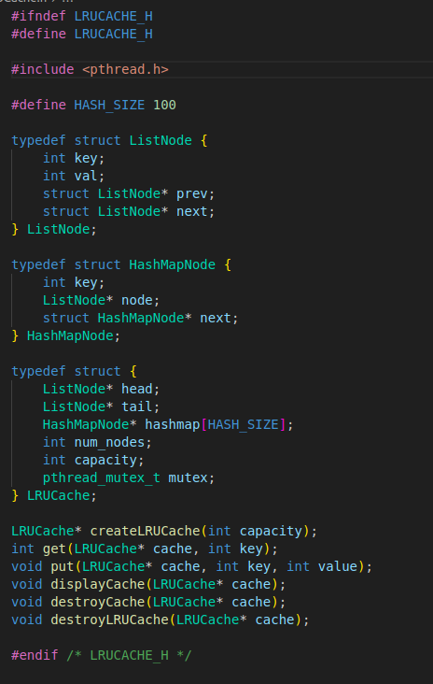
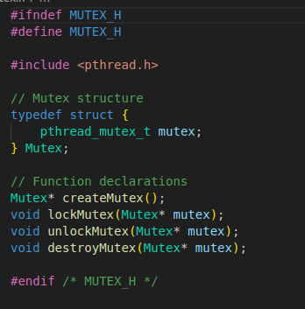
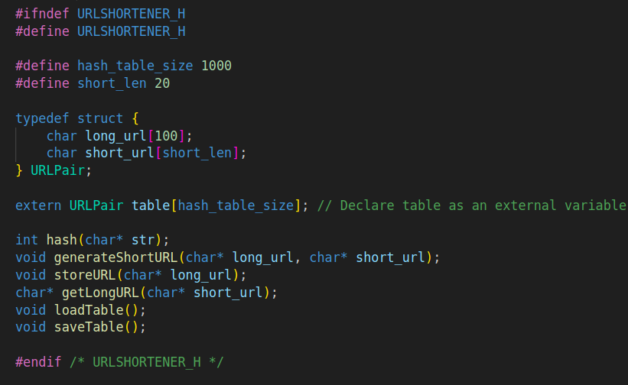
Data Structures and Function Prototypes used:
Mutex.h file
LRU.h file
URL_shortner.h file

Slide 3

Understanding the LRU (Least Recently Used) Algorithm
LRU stands for Least Recently Used, a popular caching algorithm.
It's used to manage a cache by evicting the least recently used
items first when the cache reaches its capacity.
When a new item is accessed, it is added to the cache and considered the most recently used.
If the cache is full, the least recently used item is removed to make space for the new item.
LRU relies on the principle that recently accessed items are more likely to be accessed again soon.
It's widely used in computer systems, databases, and operating systems to optimize memory usage and performance.
Implementations include using a doubly linked list and a hash map to achieve efficient access and eviction operations.

Slide 4
Time Complexity Of LRU Algorithm
1
O(1) Time for Get and Put Operations
2
Efficient Cache Eviction
3
Constant Time Access to Least Recently Used Item
4
Scalable Performance

Slide 5

Advantages and Use Cases of LRU Algorithm
The LRU algorithm offers several key advantages
efficient memory management
improved performance
enhanced cache utilization
It is widely used in caching systems, web browsers, and operating systems to ensure frequently accessed data is
readily available.
LRU is particularly beneficial in scenarios with limited memory resources, as it dynamically evicts the least recently used items to make room for new ones. This intelligent cache replacement strategy optimizes system resources and enhances overall responsiveness.

Slide 6

Implementing LRU Algorithm in Data Structures
1
Self Organized Linked List
Implementing LRU with a Doubly Linked List allows for efficient key-value removal and insertion at both ends, tracking the least recently used item.
2
Hash Table
Pairing the Linked List with a Hash Table enables constant-time lookups, updates, and evictions, making the LRU algorithm highly performant.
Dequeue

Slide 7
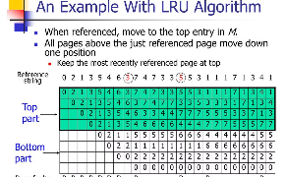
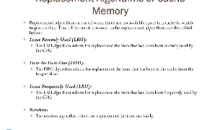
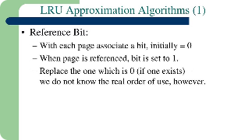
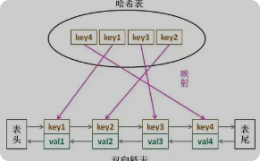
Literature Survey of LRU Algorithm
Academic Research
Comparative Studies
Opearting System
Integration
Distributed System
Applications
The LRU algorithm has been extensively studied in academic literature, with numerous research papers exploring its theoretical properties, implementation strategies, and real-world applications.
Several studies have compared the performance of LRU to other cache replacement algorithms, such as FIFO and Random, to determine the optimal strategies for different use cases.
The LRU algorithm is commonly employed in operating systems for managing virtual memory and file caching, with extensive research on its integration and optimization within these systems.
The LRU algorithm has also been studied in the context of distributed systems, such as web servers and content delivery networks, where its scalability and performance in handling large-scale caching is a key focus.

Slide 8
Hashing Literature Survey
The article titled "A Survey of Hashing Techniques and Its Applicability for Efficient Buffer Cache Management" provides an in-depth overview of various hashing techniques and their relevance in managing buffer caches efficiently. Here's a summary of the key points covered in the article:
Introduction to Hashing: Hashing is a fundamental technique used to locate records based on keys efficiently. It offers constant-time retrieval, making it attractive for applications where access speed is crucial.
Categories of Access Methods: Access methods can be categorized into sequential schemes (O(n) retrieval time), tree-structured schemes (O(log n) retrieval time), and hashing schemes (O(1) retrieval time).
Static vs. Dynamic Hashing: Static hashing provides fast access but is inflexible in dynamic environments. Dynamic hashing schemes, on the other hand, adapt to changes in data size dynamically.
Dynamic Hashing Techniques: The article surveys various dynamic hashing techniques, including Extendible Hashing, Expandable Hashing, Spiral Storage, Linear Virtual Hashing, and Cuckoo Hashing. Each technique offers a balance between access speed and memory utilization.

Slide 9
Literature Survey: The article presents a comprehensive survey of research papers discussing different hashing techniques, their performance, and suitability for various applications.
Findings from Literature Survey: The findings from the literature survey highlight the performance, advantages, and limitations of each hashing technique. Linear hashing emerges as a simple and efficient technique, especially when the cardinality of the key set is not known in advance.
Discussion: The discussion section delves into the adaptation of hashing techniques for database buffer cache management. It emphasizes the importance of optimizing access methods to minimize search times and maximize memory utilization.
Conclusion: Linear hashing with partial expansion is identified as a suitable technique for database buffer cache management with some modifications, such as adjusting the expansion sequence and implementing slab allocation for efficient memory management.
References: The article concludes with a list of references citing relevant research papers and studies in the field of hashing techniques.
Overall, the article provides valuable insights into the theory and practical applications of hashing techniques, making it a useful resource for understanding and implementing efficient buffer cache management strategies.

Slide 10
Application of LRU Algorithm
Content Delivery Networks
Web Browsers
Operating System
Database Engines
Web browsers use LRU caching to store recently accessed web pages, images, and other resources, improving load times and reducing network usage.
OS memory managers employ LRU to efficiently cache recently used pages in memory, ensuring fast access to frequently accessed data.
Database management systems leverage LRU
to cache frequently accessed data blocks, accelerating query performance and reducing disk I/O operations.
CDNs rely on LRU caching to store popular content closer to end-users, reducing latency and improving the overall user experience.

Slide 11
Comparing of LRU with other Cache Algorithms
Cache Strategies
Time Complexity
Memory Usage
Workload Adaption
LRU is a popular caching algorithm that evicts the least recently used item. Other strategies like FIFO, LFU, and Adaptive Replacement Cache have different eviction policies that suit different workloads.
LRU has O(1) time complexity for both get and put operations, making it efficient for high-throughput caching. Some alternatives like LFU have higher complexities, trading off performance for other benefits.
LRU requires maintaining a hashmap and a doubly linked list, which can have higher memory overhead compared to simpler policies like FIFO. The tradeoff is higher performance for LRU
Adaptive algorithms like ARC can adjust their eviction policy based on the workload, offering better performance across varying access patterns compared to static policies like LRU.

Slide 12

Introduction to URL Shortening
URL shortening is a technique that creates a short, easily shareable URL that redirects to a longer, original URL.
It helps make links more manageable and less cumbersome, especially for sharing on social media or in messaging apps.

Slide 13

Advantages of URL Shortening
Space-saving
Improved readability
Trackability
Branding
Example Use Cases:
Twitter: Character limit necessitates shorter URLs.
Email marketing: Cleaner and more concise links.
Social media sharing: Facilitates easy sharing and tracking.
Considerations:
Security: Risks associated with malicious shortened links.
Long-term reliability: Dependence on URL shortening services.
Conclusion:
URL shortening is a valuable tool for making long URLs more manageable, facilitating easier sharing, and providing analytics. However, it's important to consider security and reliability factors.

Slide 14
URL Shortening Literature Survey
URL shortening translates long URLs into abbreviated alternatives for easier sharing and use.
Popularized by services like TinyURL and Bitly, especially due to character limits in platforms like Twitter.
Short URL Services:
Short URLs are essential in platforms with character limitations like social media.
Some security concerns arise due to the potential for misuse by malicious actors.
Methodology:
3.1 Malicious URL Detection:
3.1.1 Importance of URL Shortening:
URL shortening creates shorter aliases for long URLs, aiding in readability and shareability.
3.2 Feature Representation for Detection:

Slide 15
Lexical Features: Properties derived from the URL name, aiding in identifying malicious patterns.
Host-based Features: Properties from the hostname, offering insights into the nature of hosts.
Content-based Features: Analysis of webpage content, providing additional context for threat detection.
3.2.2 Forwarding-based Features:
Proposal to utilize forwarding patterns to identify malicious URLs.
3.2.3 Social Media Analysis:
Focuses on behavioral analysis of users sharing and clicking on URLs to detect malicious intent.
Summary:
Various feature representations are crucial for effective malicious URL detection.
Careful consideration is needed to balance feature usefulness with resource intensity in system design

Slide 16




Techniques for Efficient URL Shortening
Hash Functions
Database Storage
Base Conversion
Caching
Leveraging hash functions to generate short, unique identifiers from long URLs is a common technique. This allows for compact, efficient URL representation.
Storing the mapping between short and long URLs in a database enables fast lookups and retrieval of the original URL.
Converting the ID or index of the stored URL to a shorter base62 or base36 representation can significantly reduce the URL length.
Implementing caching strategies at the server level can improve response times and efficiency when resolving shortened URLs.

Slide 17
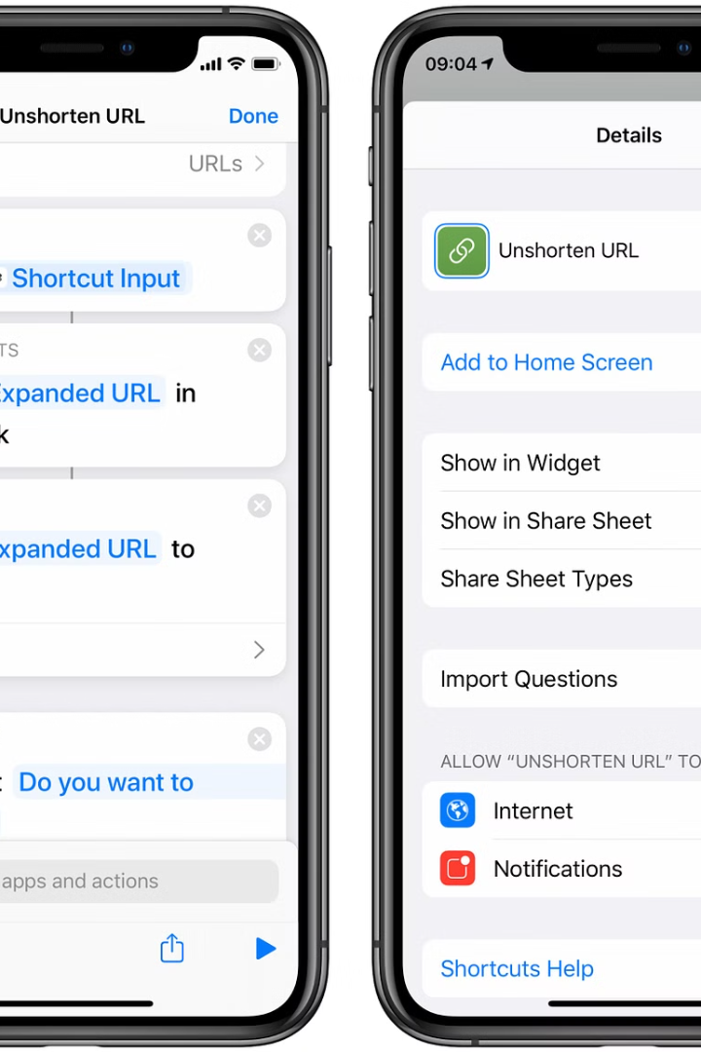

Applications and Benefits of URL Shortening
URL shortening has numerous applications, from social media sharing to analytics tracking.
It helps reduce long, unwieldy links into compact, easily shareable forms.
This enhances the user experience and improves link visibility across platforms.
The key benefits of URL shortening include improved brand recognition, better link tracking, and increased click-through rates.
URL shortening also enables the use of vanity URLs, which can be customized to reflect a company's branding or campaign message. This further enhances the professional appearance and marketing potential of shared links.

Slide 18
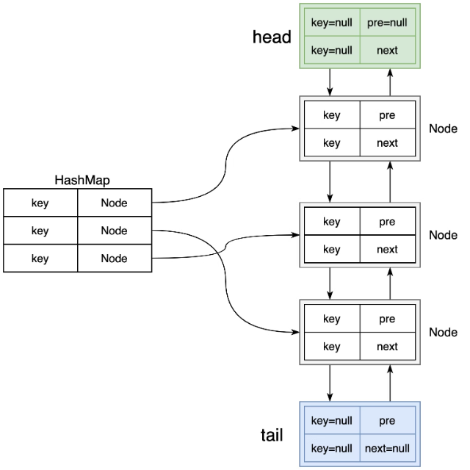
Combining LRU Algorithm and URL Shortening
By integrating the LRU (Least Recently Used) algorithm with URL shortening, developers can create efficient and scalable URL management systems.
The LRU algorithm ensures that the most frequently accessed URLs are kept in memory, while less popular ones are automatically evicted to make room for new entries.
This combination allows for rapid lookup and retrieval of shortened URLs, minimizing response times and improving the overall user experience.
Additionally, the LRU algorithm helps maintain the cache size, preventing memory leaks and ensuring the system's long-term sustainability.

Slide 19

Conclusion and Future Scope
After exploring the fundamentals of the Least Recently Used (LRU) algorithm and the principles behind URL shortening services, we can conclude that these concepts play a crucial role in optimizing data structures and enhancing web-based experiences.
Looking ahead, there are several potential areas for future exploration and improvement:
Further research and development of more efficient LRU algorithms to handle larger datasets.
Exploring new techniques and strategies for URL shortening to improve performance and security.
Integration of LRU algorithm and URL shortening in other applications and systems for enhanced user experiences.
By continuing to innovate and refine these concepts, we can unlock new possibilities and create even better solutions in the future.

Slide 20
References
https://www.researchgate.net/publication/324124173_A_SURVEY_OF_HASHING_TECHNIQUES_AND_ITS_APPLICABILITY_FOR_EFFICIENT_BUFFER_CACHE_MANAGEMENT --> Research Gate --> Hashing
https://www.researchgate.net/publication/267438447_Self-Organizing_Doubly_Linked_Lists Research Gate --> Self Organizing DLL
https://www.researchgate.net/publication/281640595_Security_Threats_of_URL_Shortening_A_User's_Perspective--> Research Gate -->URL shortening

